Slide 1
RCE Sask Project
ENSE 871
Instructor: Dr. Tim Maciag
Team ints:
Amir, Helly, Lakshay, Vandan
7 April 2022

Slide 2
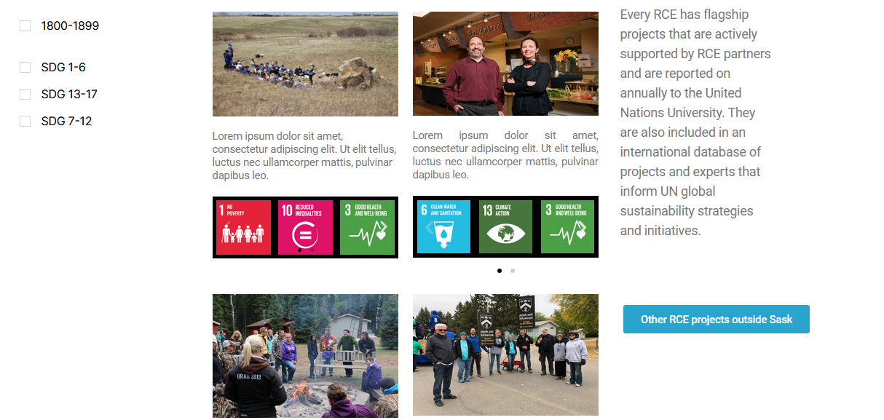
Intended Project Page

Slide 3
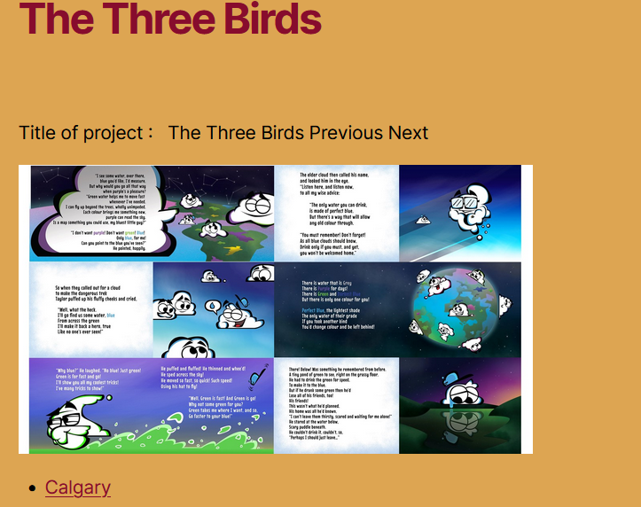
Project page

Slide 4
Project Definition
Designing a page for hosting RCE Sask projects
Constrains:
Wordpress
Theme: 2020
No paid plugins etc.
ppt source: UoR presentation template, https://www.uregina.ca/external/communications/visual-id/pp-template.html, accessed at 07,20,2021

Slide 5
Features
Simple to use and update
Search and filter included
Projects as posts
Responsive
ENSE 871 Usability Research & Engineering
Final Project
ppt source: UoR presentation template, https://www.uregina.ca/external/communications/visual-id/pp-template.html, accessed at 07,20,2021

Slide 6

P
Paper: Design Complexity Measurement and Testing
ppt source: UoR presentation template, https://www.uregina.ca/external/communications/visual-id/pp-template.html, accessed at 07,20,2021

Slide 7
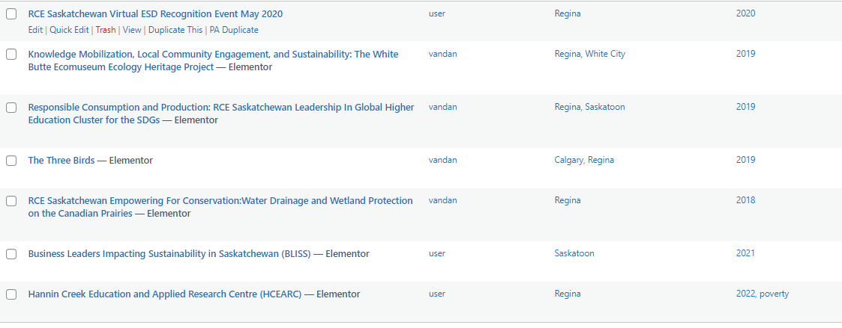
New Projects
ppt source: UoR presentation template, https://www.uregina.ca/external/communications/visual-id/pp-template.html, accessed at 07,20,2021

Slide 8
Plugins
Search and Filter Pro
Elementor Free
WPVivid Backup
That’s all!
ENSE 871 Usability Research & Engineering
Final Project
ppt source: UoR presentation template, https://www.uregina.ca/external/communications/visual-id/pp-template.html, accessed at 07,20,2021

Slide 9

Cons
Basket idea was not possible
Projects shown are not neat enough
Search and filter pro costs 20$
ENSE 871 Usability Research & Engineering
Final Project
ppt source: UoR presentation template, https://www.uregina.ca/external/communications/visual-id/pp-template.html, accessed at 07,20,2021

Slide 10
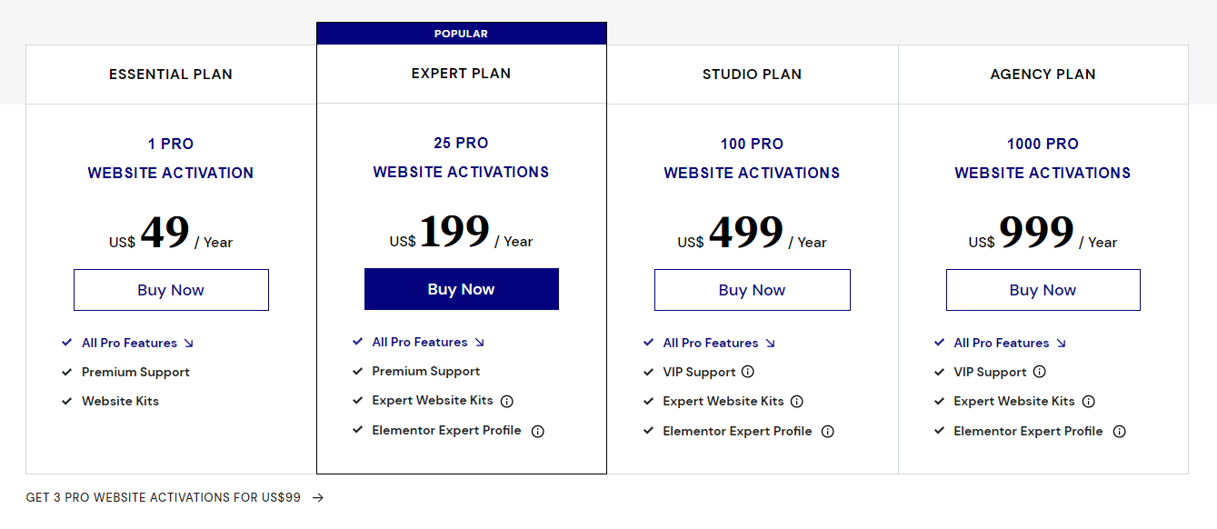
Future Work - Suggestions
Elementor pro – Cleans up the projects shown.
ENSE 871 Usability Research & Engineering
Final Project
ppt source: UoR presentation template, https://www.uregina.ca/external/communications/visual-id/pp-template.html, accessed at 07,20,2021

Slide 11
Future Work - Suggestions
WooCommerce – Basket idea
But a Different theme is required
Also cleans the projects shown
0-100$ for themes.
ENSE 871 Usability Research & Engineering
Final Project
ppt source: UoR presentation template, https://www.uregina.ca/external/communications/visual-id/pp-template.html, accessed at 07,20,2021

Slide 12
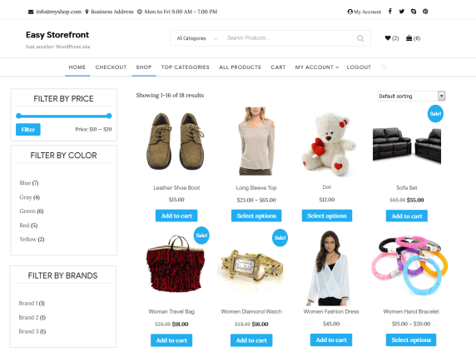
ENSE 871 Usability Research & Engineering
Final Project
ppt source: UoR presentation template, https://www.uregina.ca/external/communications/visual-id/pp-template.html, accessed at 07,20,2021

Slide 13
Thank you for your attention !

